Slide 1
Prior-aware Neural Network for Partially-Supervised Multi-Organ Segmentation and Hyper-Pairing Network for Multi-Phase PDAC Segmentation
Yuyin Zhou
Johns Hopkins University

Slide 2
Motivation
Multi-organ segmentation from medical images
Essential for many clinical applications
Dominant method
Deep learning based
Fully-supervision
Requires a large labeled training set which is time-consuming and costly
precise annotations must be hand annotated by experienced radiologists and carefully checked by additional experts
requires tedious manual input.
Notes:
Existing CNN-based segmentation methods mainly focus on looking for increasingly powerful networks architectures.

Slide 3
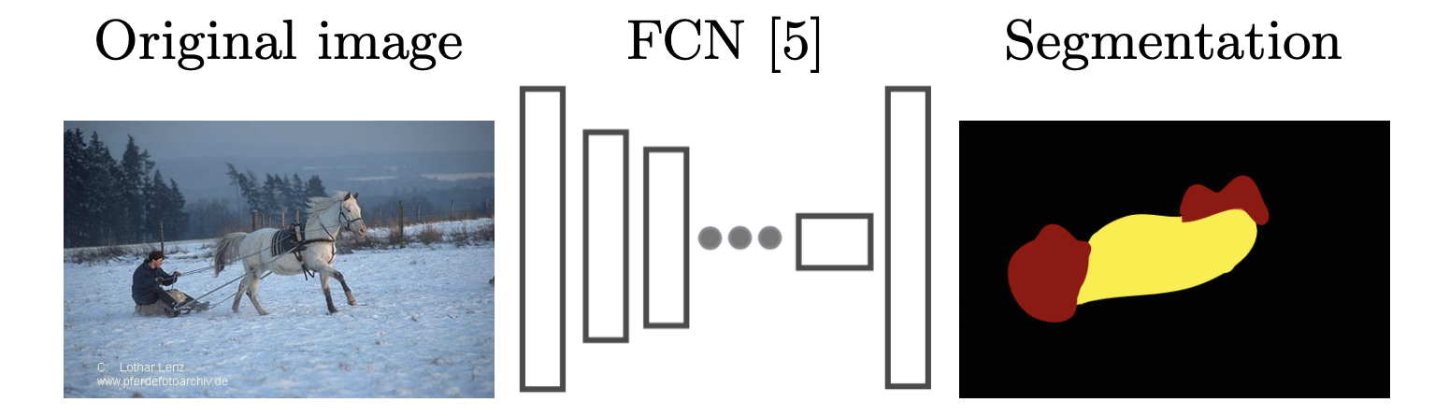
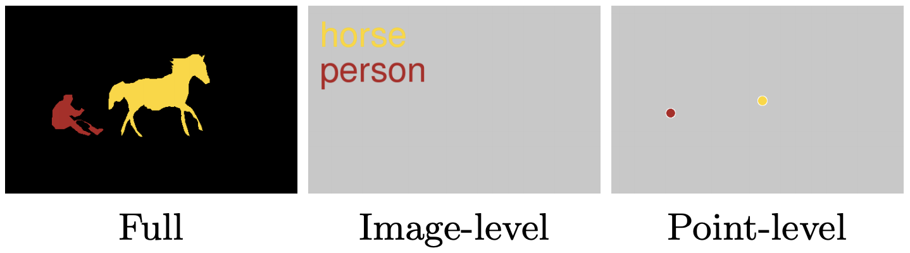
Many weak labels exist!
[1] Bearman, Amy, et al. “What’s the point: Semantic segmentation with point supervision.” ECCV 2016.
Notes:
The most common setting is where only image-level labels for the presence or absence of classes are provided during training [4,20,21,22,23,24,25], but other forms of weak supervision have been explored as well, such as bounding box annotations [4], eye tracks [26], free-form scribbles or noisy web tags The most natural way for humans to refer to an object is by pointing: “That cat over there” (point) or “What is that over there?” (point). Psychology research has indicated that humans point to objects in a consistent and predictable way

Slide 4
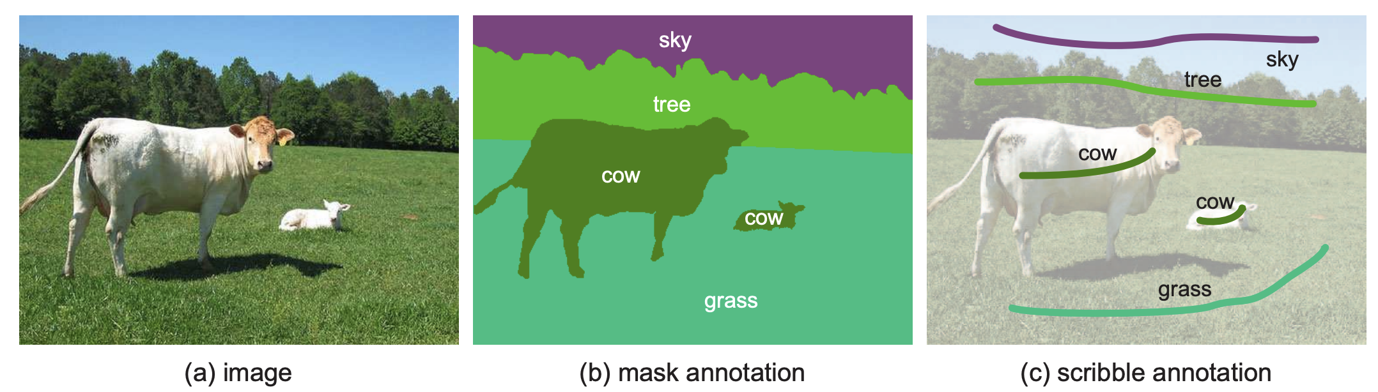
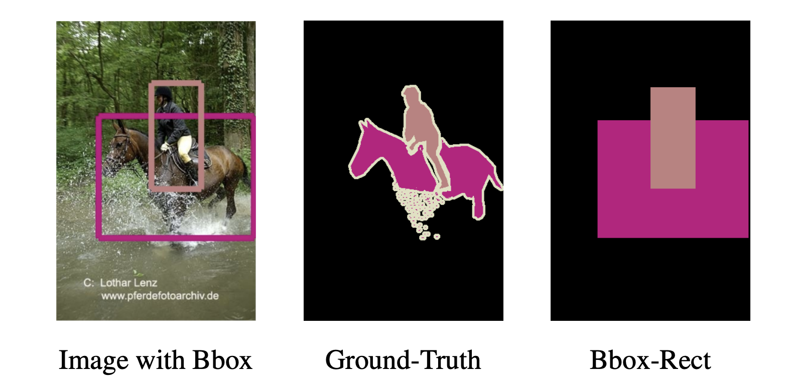
Many weak labels exist!
[2] Lin, Di, et al. "Scribblesup: Scribble-supervised convolutional networks for semantic segmentation." CVPR 2016.
[3] Papandreou, George, et al. “Weakly-and semi-supervised learning of a deep convolutional network for semantic image segmentation.” CVPR 2015.
Notes:
The procedure of annotating segmentation masks is very similar to interactive image segmentation [4], which has been a widely studied problem in the past decade [4, 26, 17, 11, 16, 19, 6]. Among various forms of user interactions, scribbles are particularly popular [4, 17, 11, 16, 19, 6] and have been recognized as a user-friendly way of interacting.

Slide 5
Summary
Many types of supervision exist and they are more easily accessible than pixel-wise labels.
Propose different loss terms to guide the supervision in current CNN-based methods

Slide 6
Semi-supervision in medical image analysis
Self-training [4]:
Train an FCN on both labeled and unlabeled data, and alternately update automated segmentations (pseudo-labels) for unlabeled data as well as the network parameters [3]
errors induced by inaccurate pseudo-labels will be reinforced by the network during training.
How to improve the quality of pseudo-labels
CT are 3D volumes
Multi-view property, i.e., the axial, coronal, and sagittal slices
Co-training as a natural paradigm to deal with multi-view property
[3] W. Bai, O. Oktay, M. Sinclair, H. Suzuki, M. Rajchl, G. Tarroni, B. Glocker, A. King, P. M. Matthews, and D. Rueckert. Semi-supervised learning for network-based cardiac mr image segmentation. In MICCAI2017
Notes:
Apart from full supervision, what are the other types of supervisions?

Slide 7
Semi-supervision in medical image analysis
Deep Multi-Planar Co-training
learned in a co-training style which can mine consensus information from multiple planes like the sagittal, coronal, and axial planes
Multi-planar fusion is applied to generate more reliable pseudo-labels
[4] Zhou, Yuyin, et al. "Semi-supervised 3D abdominal multi-organ segmentation via deep multi-planar co-training." 2019 WACV. IEEE, 2019

Slide 8
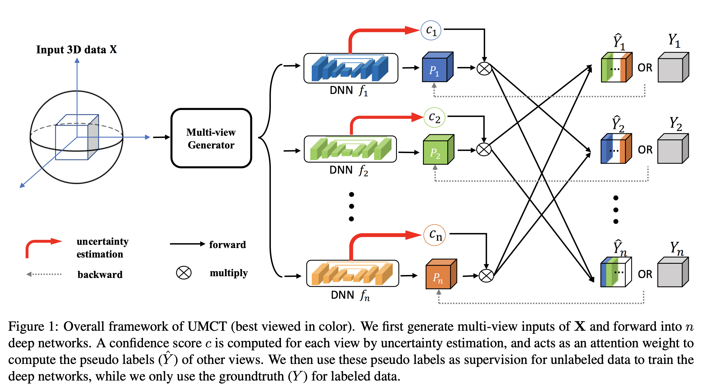
Semi-supervision in medical image analysis
[5] Xia, Yingda, et al. "3D Semi-Supervised Learning with Uncertainty-Aware Multi-View Co-Training." arXiv

Slide 9
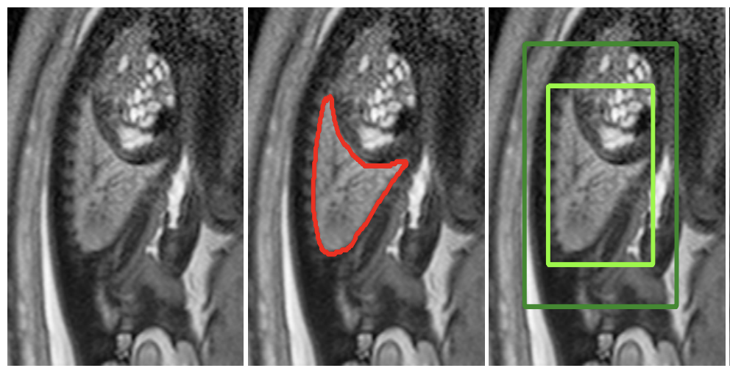
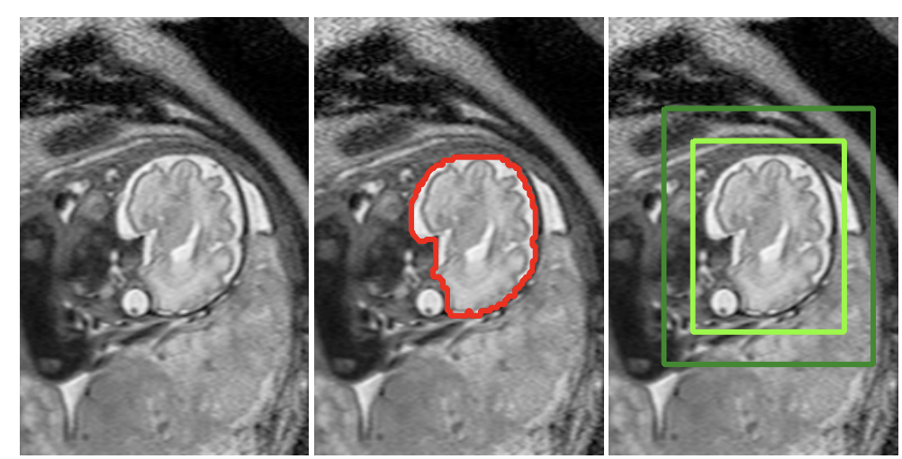
Weak supervisions in Medical Image Analysis – bounding boxes
[6] M. Rajchl et al. Deepcut: Object segmentation from bounding box annotations using convolutional neural networks. TMI, 2017

Slide 10
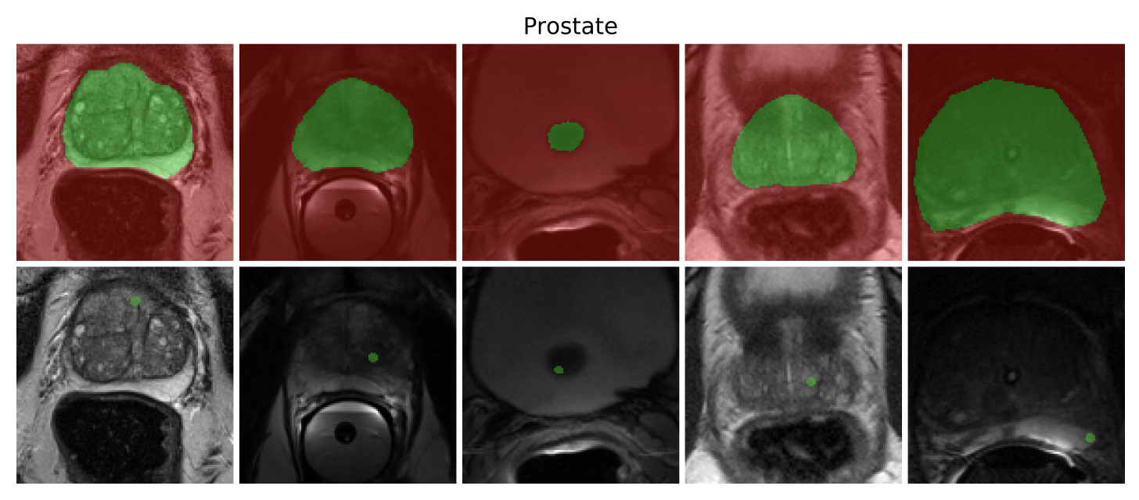
Weak supervisions in Medical image analysis
[7] Hoel Kervadec, et al. “Constrained-CNN Losses for Weakly Supervised Segmentation.” Medical Image Analysis 2019

Slide 11
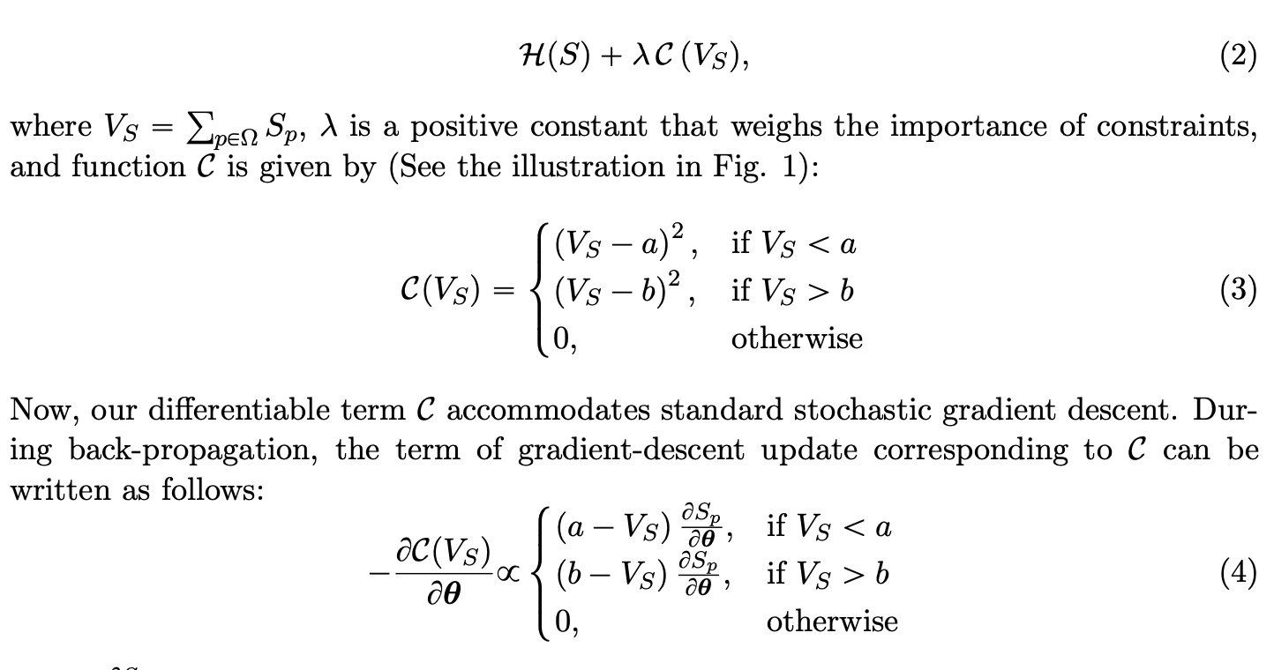
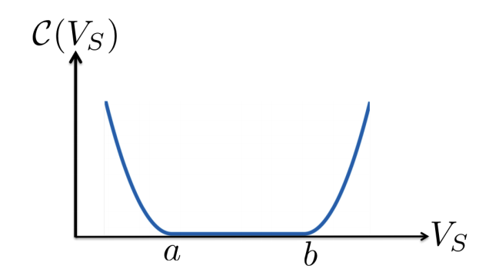

Slide 12
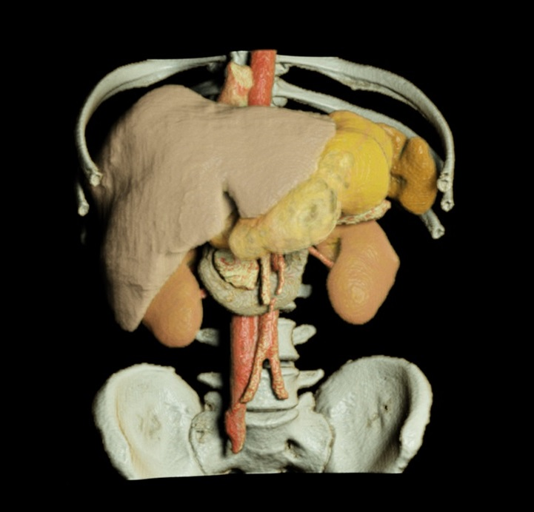
Prior-aware Neural Network for Partially-Supervised Multi-Organ

Slide 13
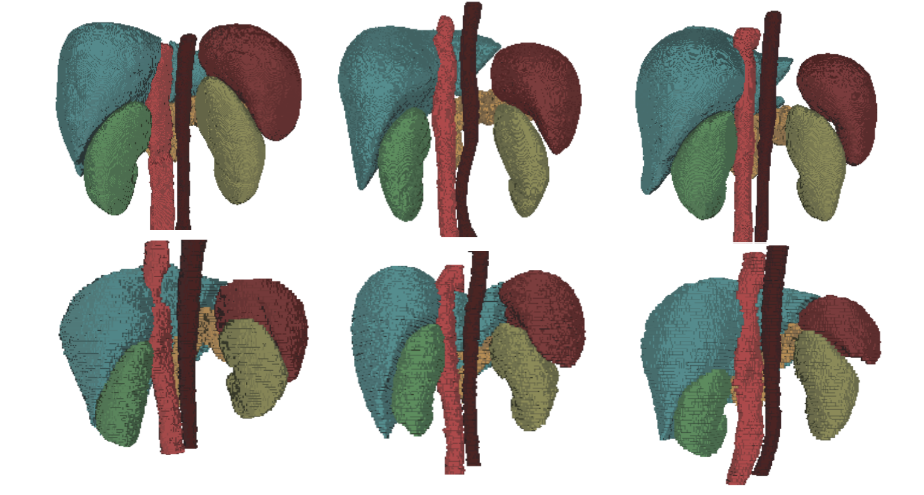
Motivation – Priors

Slide 14
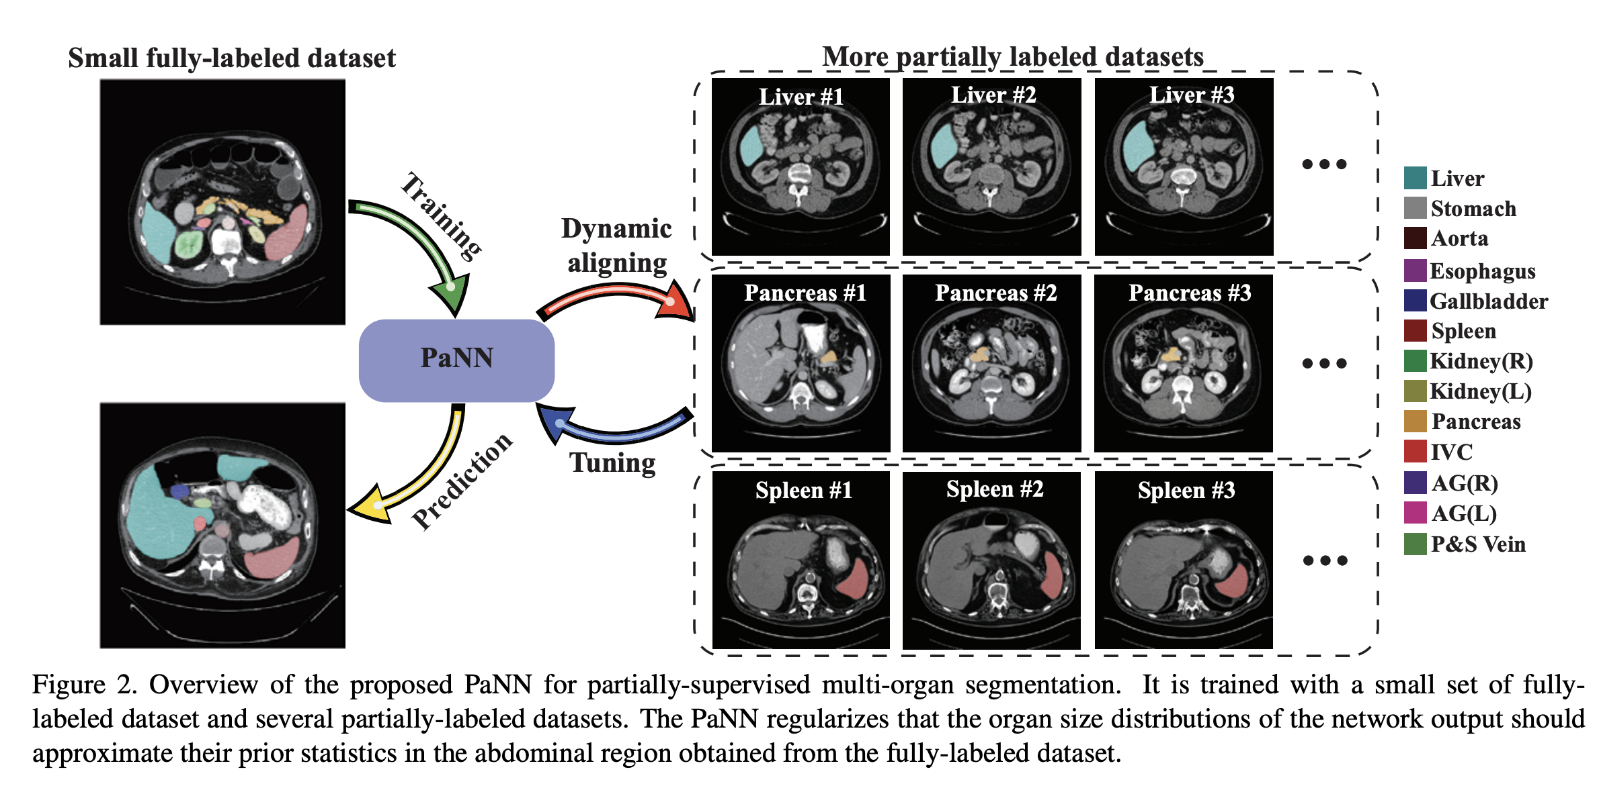
Motivation

Slide 15
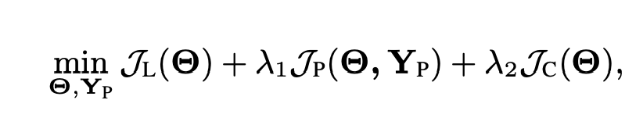
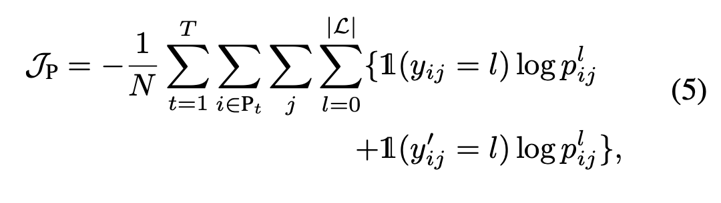
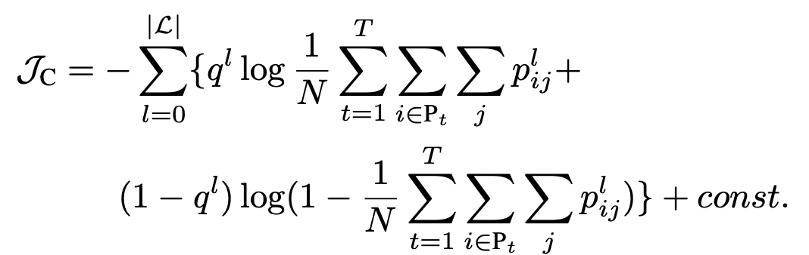
PaNN

Slide 16
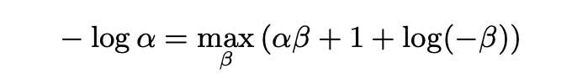
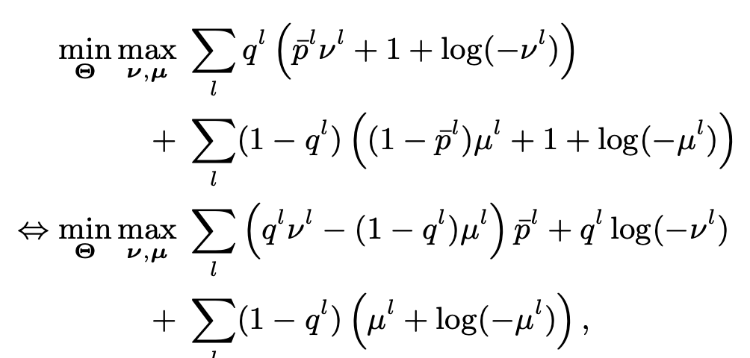
[8] Y. Liu, J. Chen, and L. Deng. An unsupervised learning method exploiting sequential output statistics. In NIPS, 2017

Slide 17
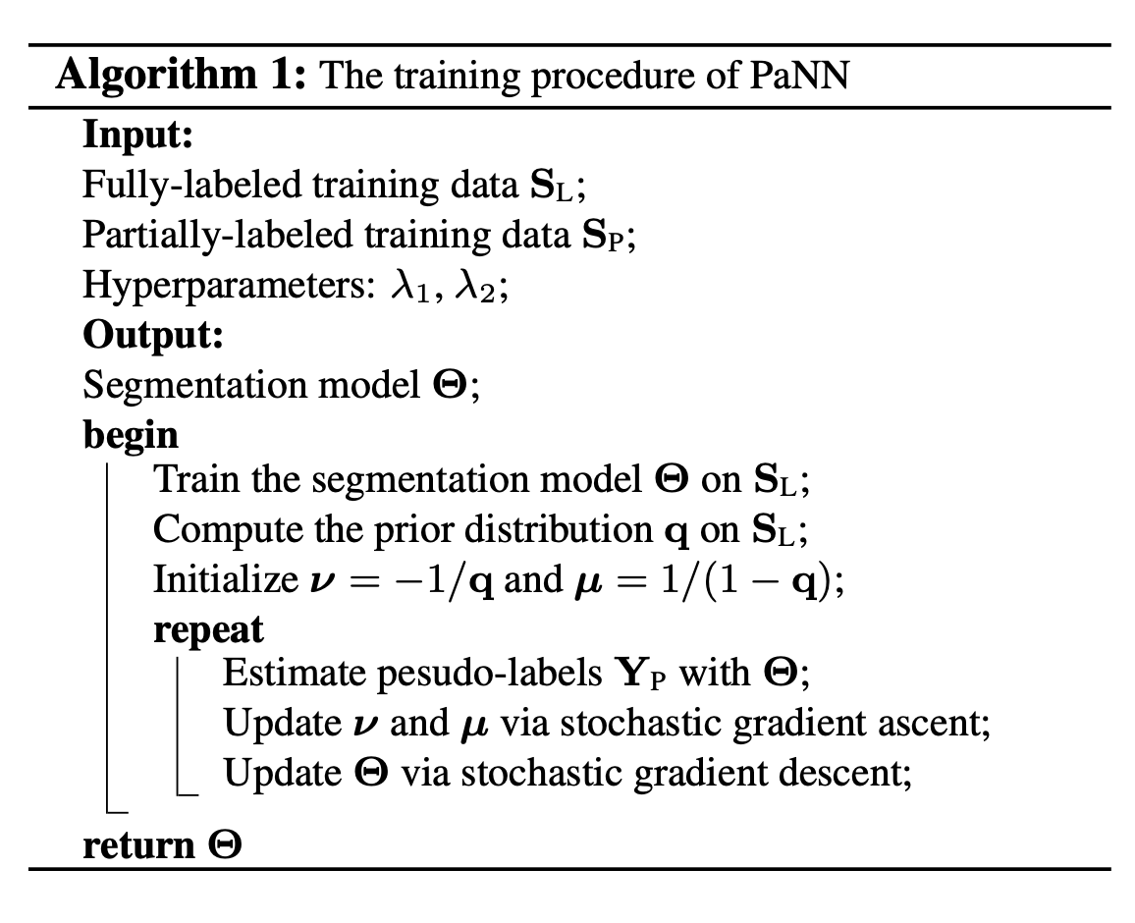
Overall Framework

Slide 18
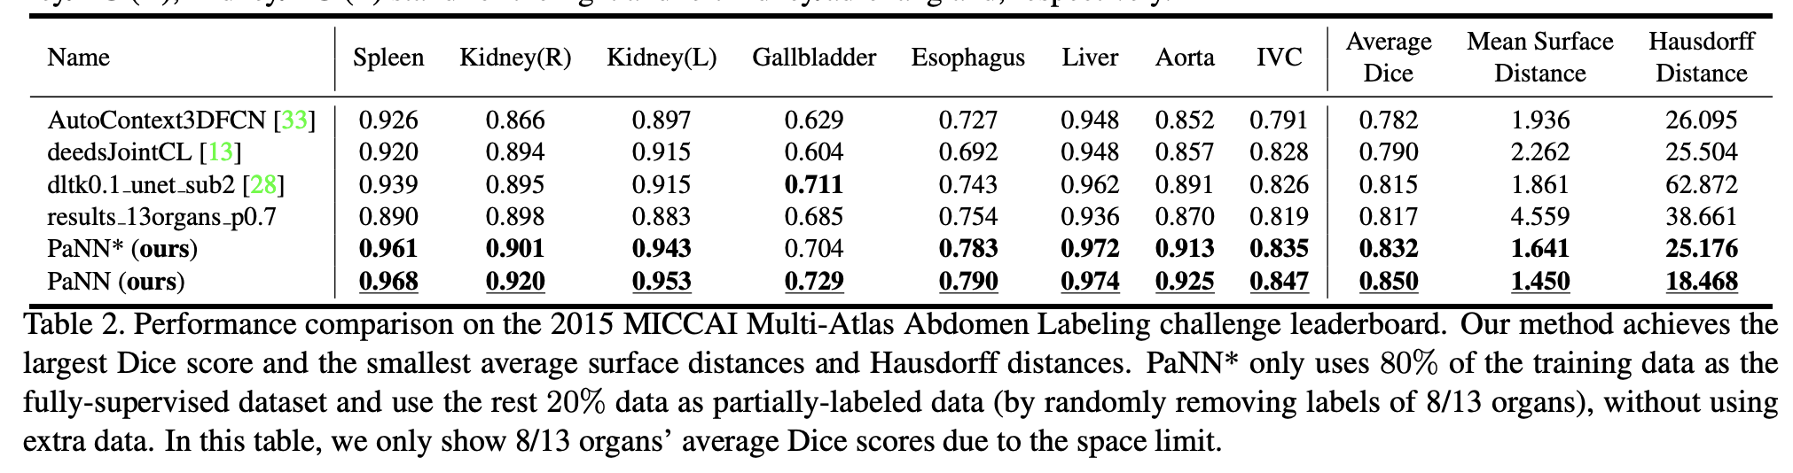
Experimental Results

Slide 19
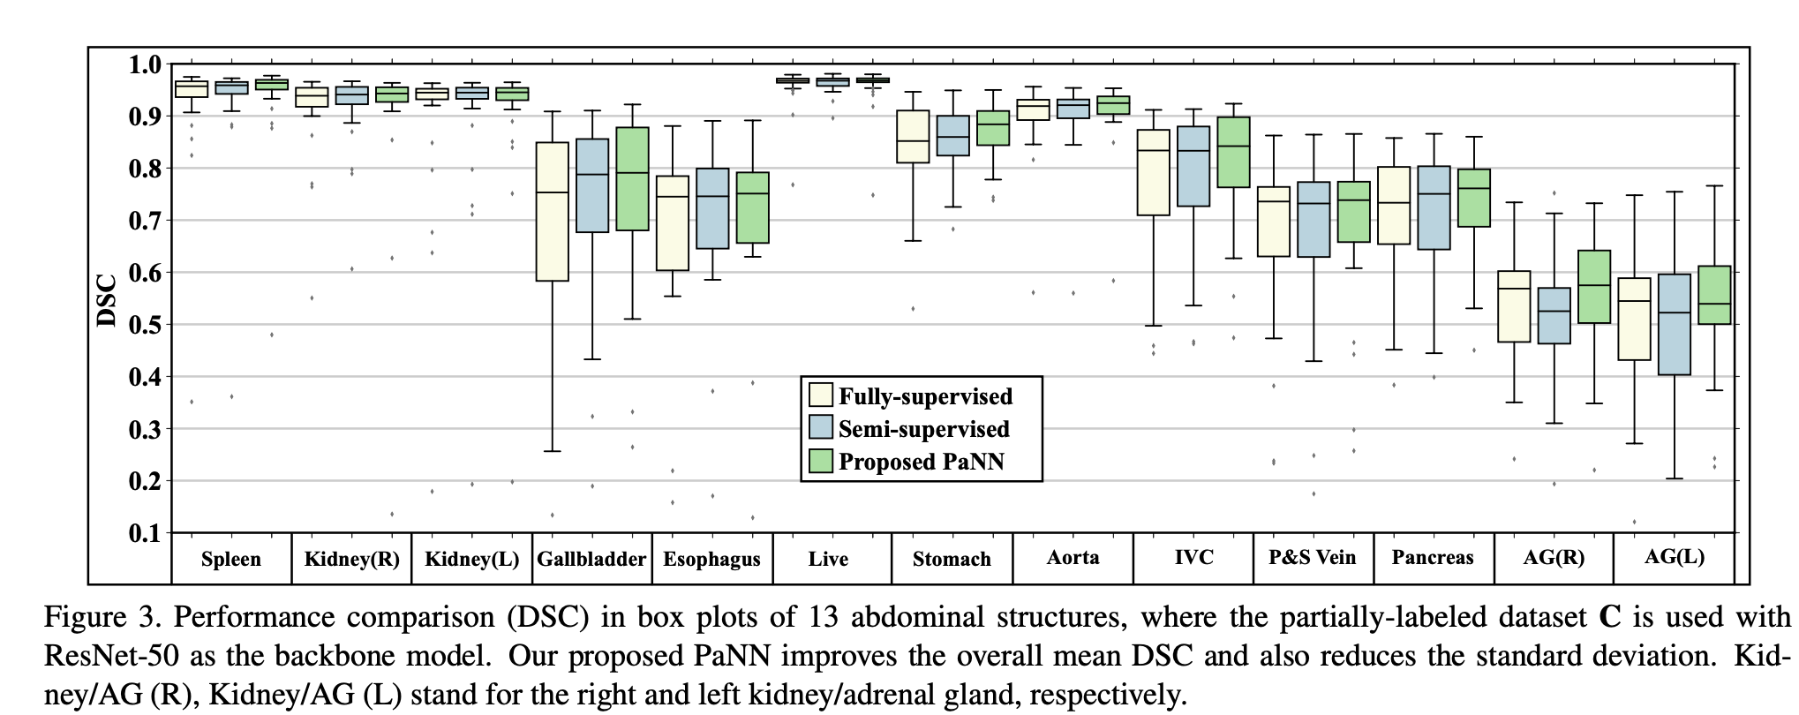
Experimental Results

Slide 20
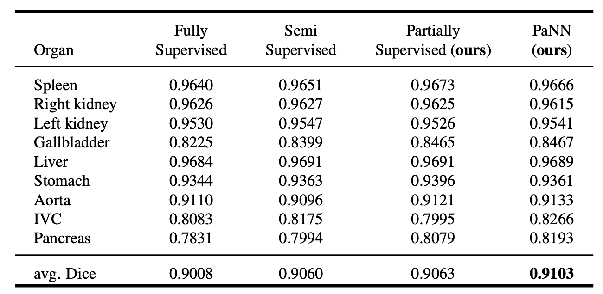
Experimental Results
Notes:
.

Slide 21
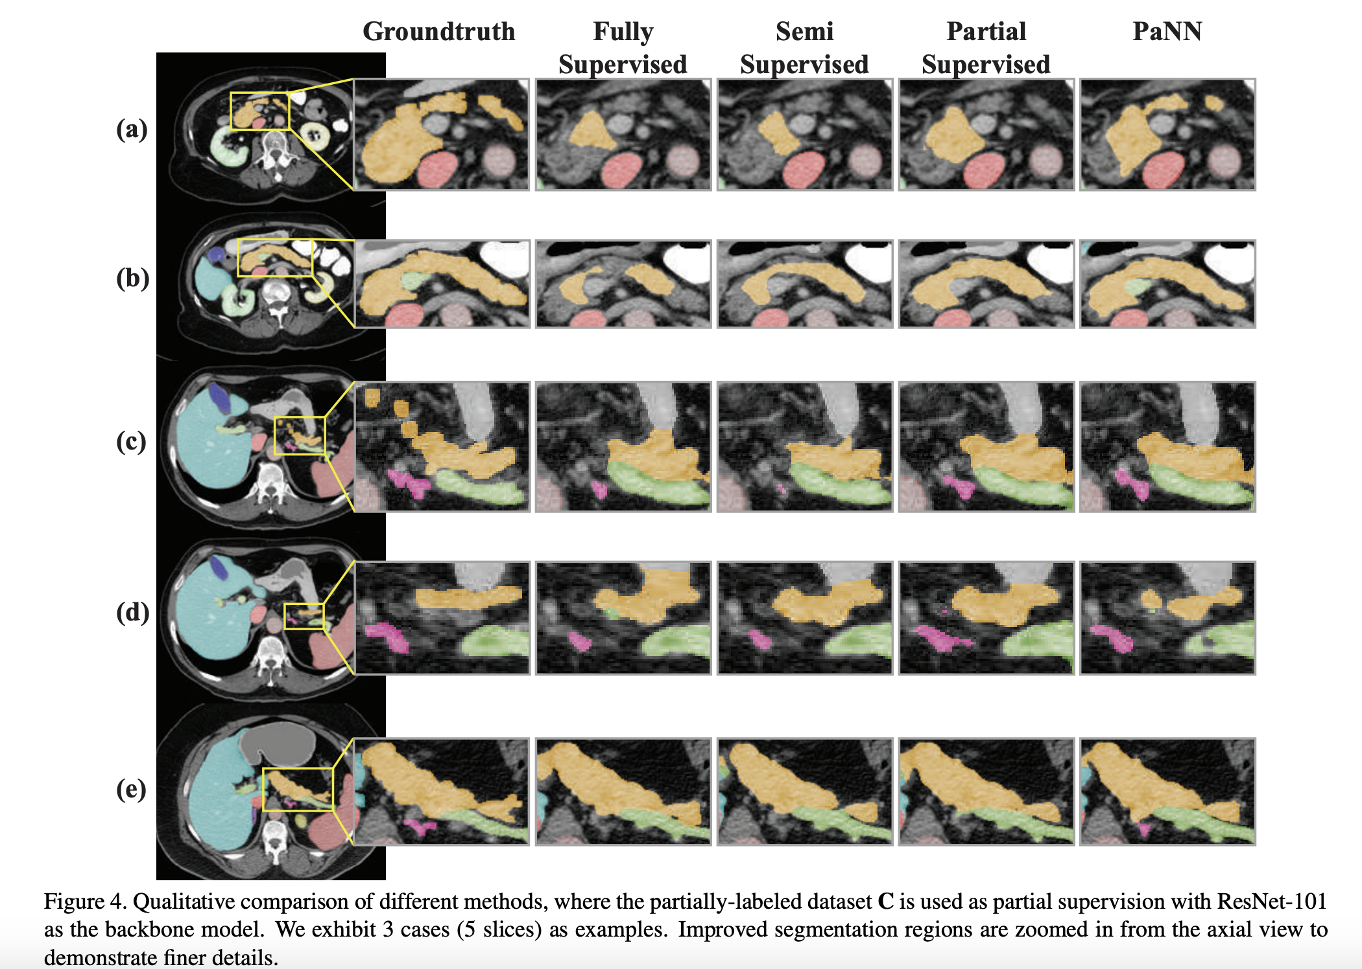
Experimental Results

Slide 22
Hyper-Pairing Network for Multi-Phase Segmentation

Slide 23
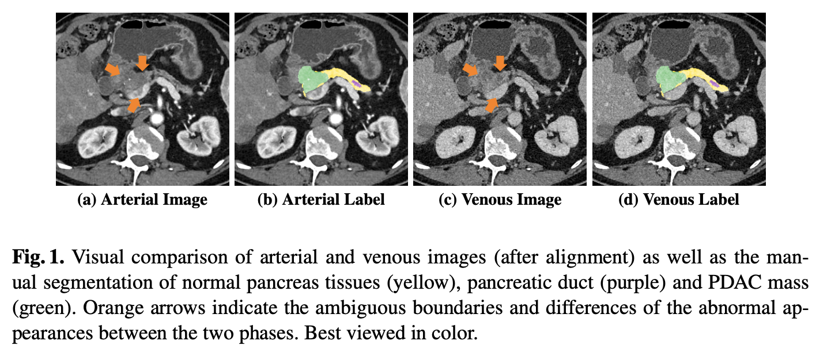
Background

Slide 24
Motivation
For better detection of PDAC mass, dual-phase pancreas protocol using contrast-enhanced CT imaging are recommended.
While how to efficiently integrate information from multi-modalities has been widely studied, the direction on learning multi-phase information has been rarely explored, especially for tumor detection and segmentation purposes.

Slide 25
Challenges
Segmentation of pancreatic lesion, e.g., cysts [17], is more difficult than organ segmentation due to its smaller sizes, lower contrast and texture similarity, etc.
Existing algorithms are optimized for segmenting only one type of input, and therefore cannot be directly applied to handle multi-phase data.
How to properly handle the variations between different views requires a smart information exchange strategy between different phases

Slide 26
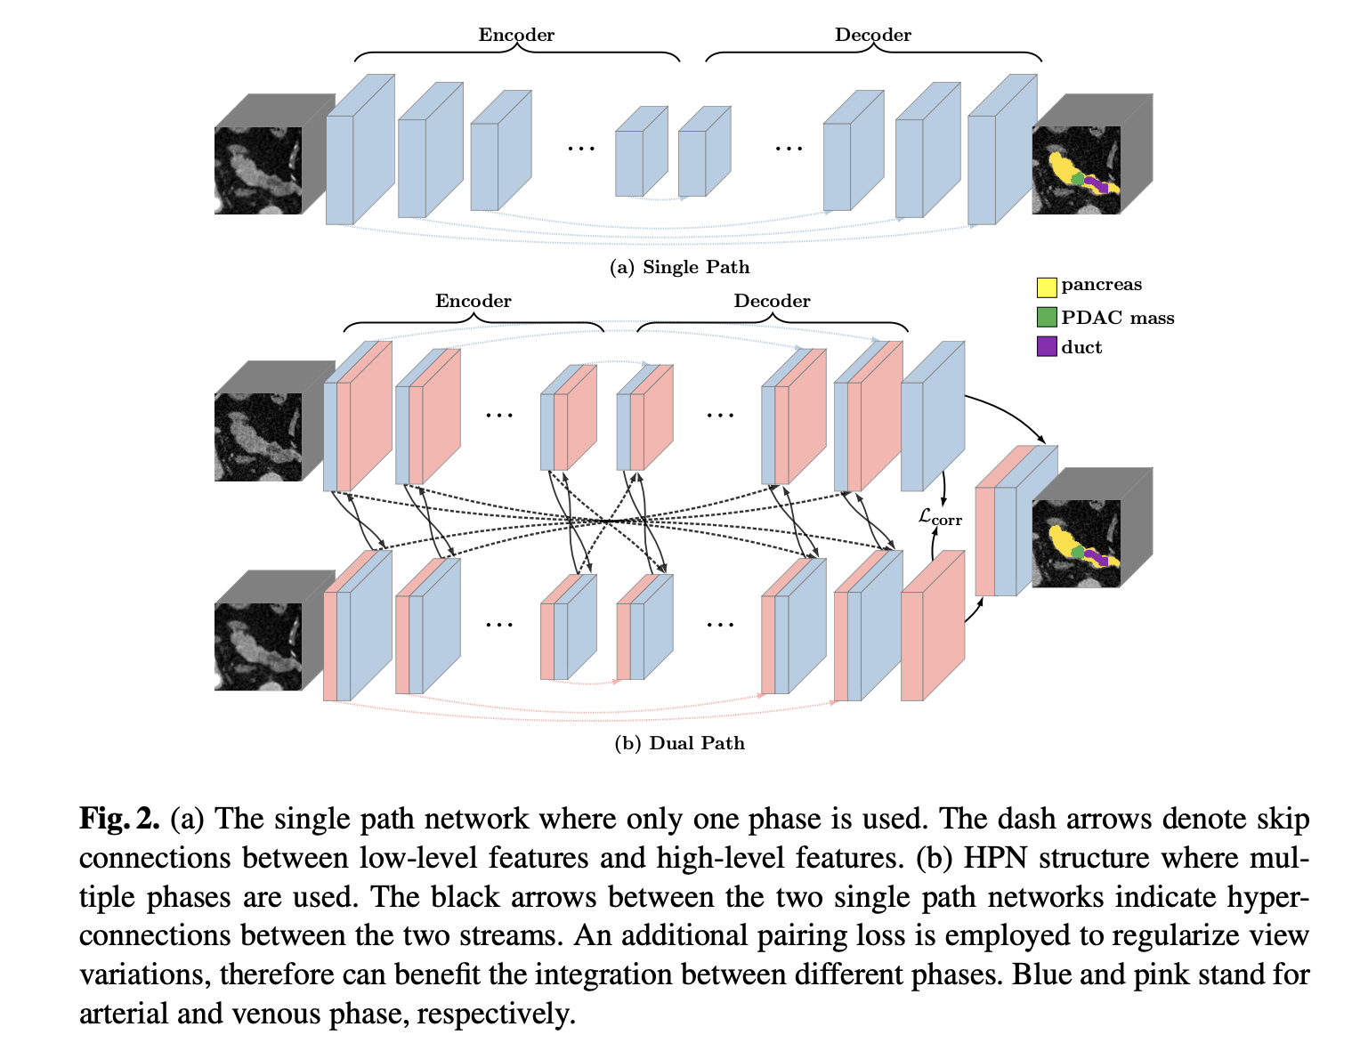
HPN

Slide 27
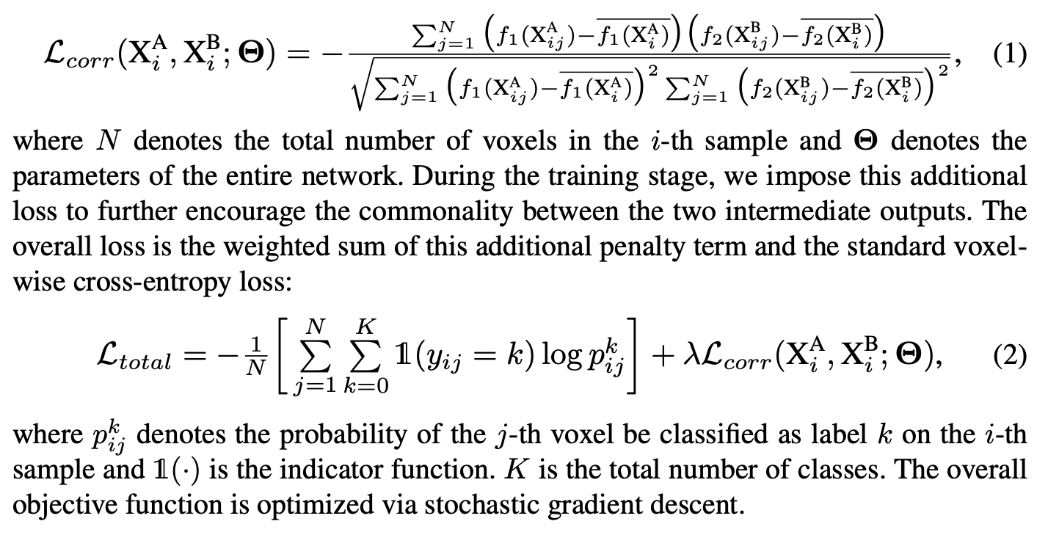
HPN

Slide 28
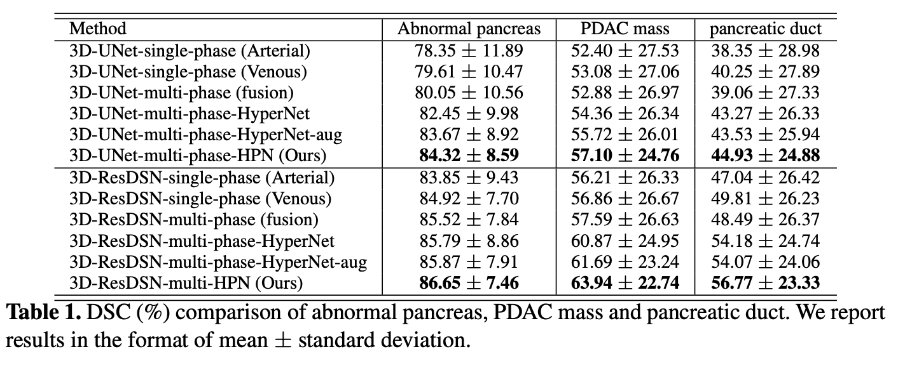
Results

Slide 29
Potential clinical value
11/239 cases are false negatives which failed to detect any PDAC mass using either phase (Dice = 0%). Out of these 11 cases, 7 cases are successfully detected by HPN.
HPN not only improves segmentation accuracy but also reduces missing rates, which is more clinical meaningful.

Slide 30
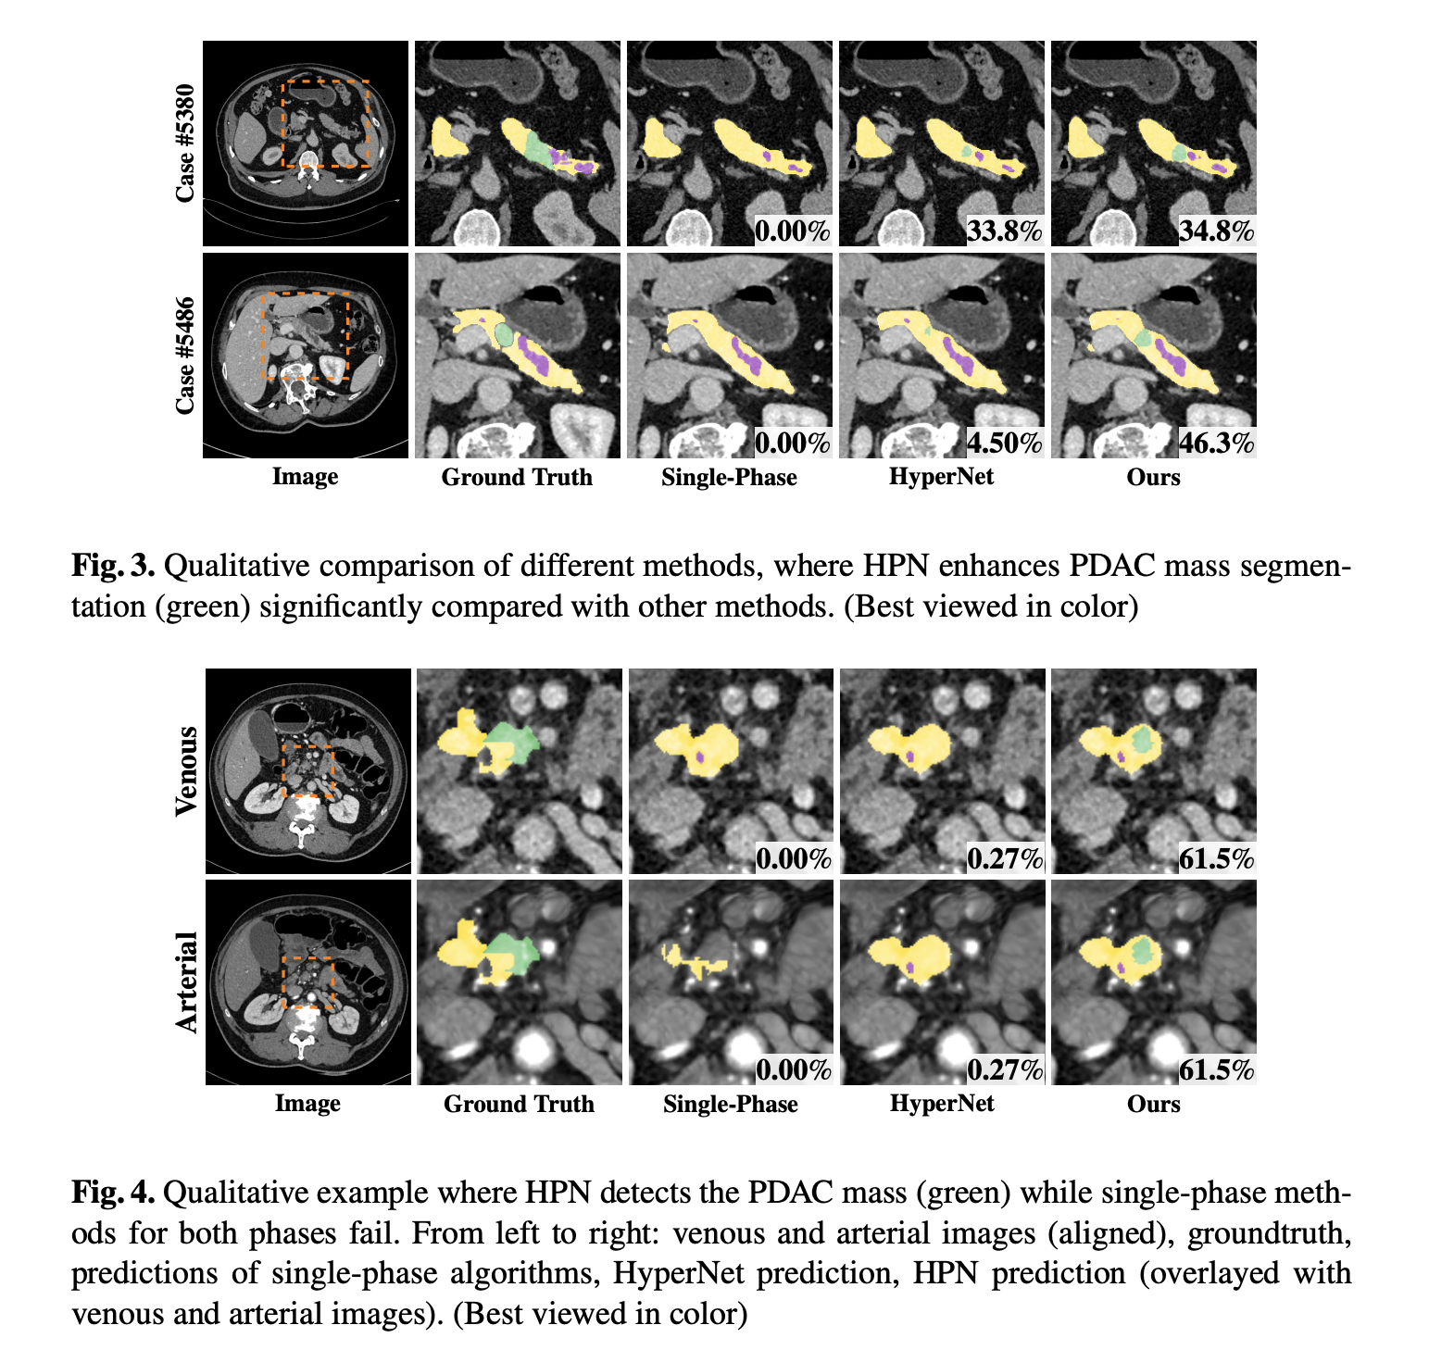

Slide 31
Q & A
Thanks for listening!

